Slide 1
THE PERSONAL FINANCIAL MANAGEMENT APP
PRESENTED BY
D.Swetha-812022104084
S.Srimathi-812022104075
A.Shabnam Sajitha-812022104309

Slide 2
DESCRIPTION
Our app is a user-friendly, all-in-one financial tool designed to help individuals take control of their personal finances effortlessly. From budgeting and expense tracking to savings goals and investment insights, this app provides users with everything they need to make smarter financial decisions.

Slide 3
SOURCE CODE
package com.example.expensestracker
import android.annotation.SuppressLint
import android.content.Intent
import android.os.Bundle
import android.util.Log
import androidx.activity.ComponentActivity
import androidx.activity.compose.setContent
import androidx.compose.foundation.ScrollState
import androidx.compose.foundation.layout.*
import androidx.compose.foundation.lazy.LazyColumn
import androidx.compose.foundation.lazy.LazyRow
import androidx.compose.foundation.lazy.items
import androidx.compose.foundation.verticalScroll
import androidx.compose.material.*

Slide 4
import androidx.compose.runtime.Composable
import androidx.compose.ui.Modifier
import androidx.compose.ui.graphics.Color
import androidx.compose.ui.text.font.FontWeight
import androidx.compose.ui.text.style.TextAlign
import androidx.compose.ui.tooling.preview.Preview
import androidx.compose.ui.unit.dp
import androidx.compose.ui.unit.sp
import com.example.expensestracker.ui.theme.ExpensesTrackerTheme
class ViewRecordsActivity : ComponentActivity() {
private lateinit var itemsDatabaseHelper: ItemsDatabaseHelper
@SuppressLint("UnusedMaterialScaffoldPaddingParameter", "SuspiciousIndentation")
override fun onCreate(savedInstanceState: Bundle?) {
super.onCreate(savedInstanceState)
itemsDatabaseHelper = ItemsDatabaseHelper(this)

Slide 5
setContent {
Scaffold(
// in scaffold we are specifying top bar.
bottomBar = {
// inside top bar we are specifying
// background color.
BottomAppBar(backgroundColor = Color(0xFFadbef4),
modifier = Modifier.height(80.dp),
// along with that we are specifying
// title for our top bar.
content = {
Spacer(modifier = Modifier.width(15.dp))
Button(
onClick = {
startActivity(
Intent(
applicationContext,
AddExpensesActivity::class.java
)
)
},

Slide 6
colors = ButtonDefaults.buttonColors(backgroundColor = Color.White),
modifier = Modifier.size(height = 55.dp, width = 110.dp)
)
{
Text(
text = "Add Expenses", color = Color.Black, fontSize = 14.sp,
textAlign = TextAlign.Center
)
}
Spacer(modifier = Modifier.width(15.dp))
Button(
onClick = {
startActivity(
Intent(
applicationContext,
SetLimitActivity::class.java
)
)
},

Slide 7
colors = ButtonDefaults.buttonColors(backgroundColor = Color.White),
modifier = Modifier.size(height = 55.dp, width = 110.dp)
)
{
Text(
text = "Set Limit", color = Color.Black, fontSize = 14.sp,
textAlign = TextAlign.Center
)
}
Spacer(modifier = Modifier.width(15.dp))
Button(
onClick = {
startActivity(
Intent(
applicationContext,
ViewRecordsActivity::class.java

Slide 8
)
)
},
colors = ButtonDefaults.buttonColors(backgroundColor = Color.White),
modifier = Modifier.size(height = 55.dp, width = 110.dp)
)
{
Text(
text = "View Records", color = Color.Black, fontSize = 14.sp,
textAlign = TextAlign.Center
)
}
}
)
}
) {
val data=itemsDatabaseHelper.getAllItems();
Log.d("swathi" ,data.toString())
val items = itemsDatabaseHelper.getAllItems()
Records(items)

Slide 9
}
}
}
}
@Composable
fun Records(items: List<Items>) {
Text(text = "View Records", modifier = Modifier.padding(top = 24.dp, start = 106.dp, bottom = 24.dp ), fontSize = 30.sp, fontWeight = FontWeight.Bold)
Spacer(modifier = Modifier.height(30.dp))
LazyRow(
modifier = Modifier
.fillMaxSize()
.padding(top = 80.dp),
horizontalArrangement = Arrangement.SpaceBetween
){
item {

Slide 10
LazyColumn {
items(items) { items ->
Column(modifier = Modifier.padding(top = 16.dp, start = 48.dp, bottom = 20.dp)) {
Text("Item_Name: ${items.itemName}")
Text("Quantity: ${items.quantity}")
Text("Cost: ${items.cost}")
}
}
}
}
}
}

Slide 11
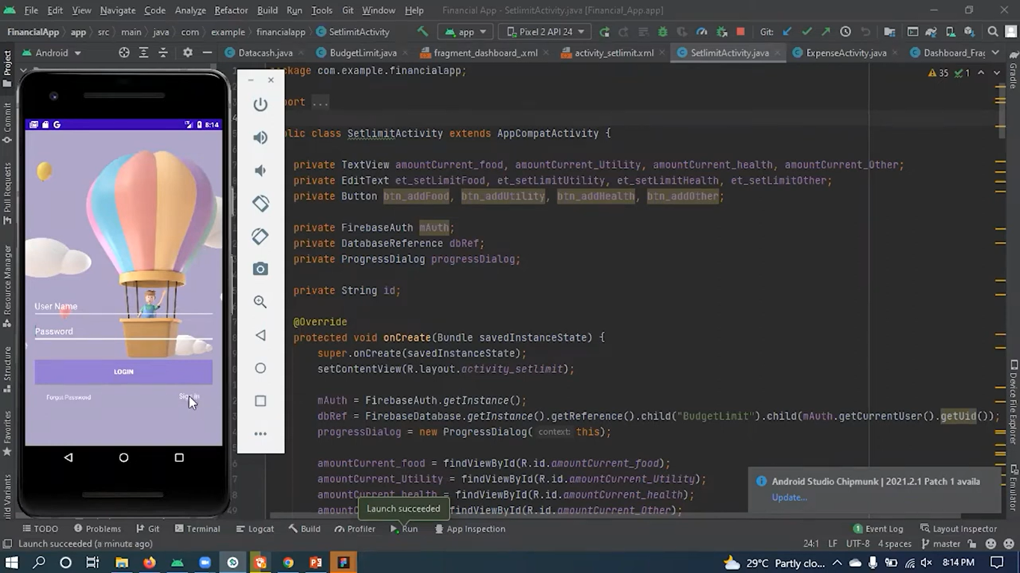
OUTPUT

Slide 12
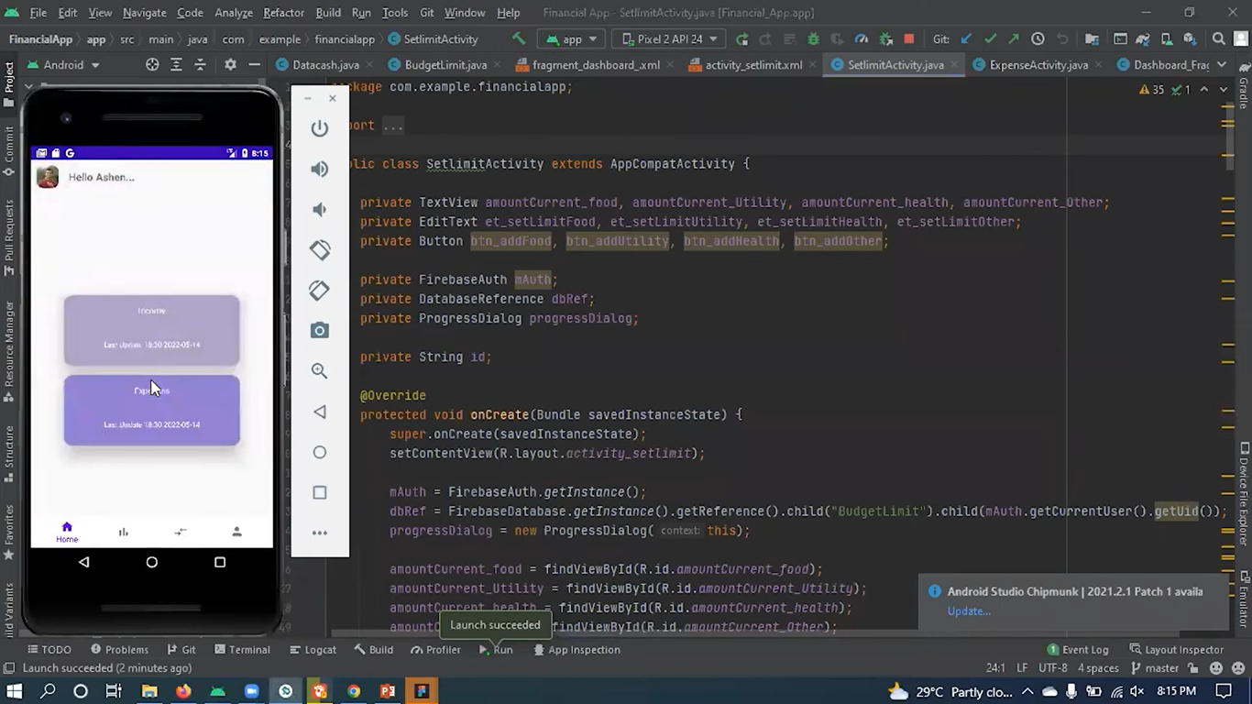
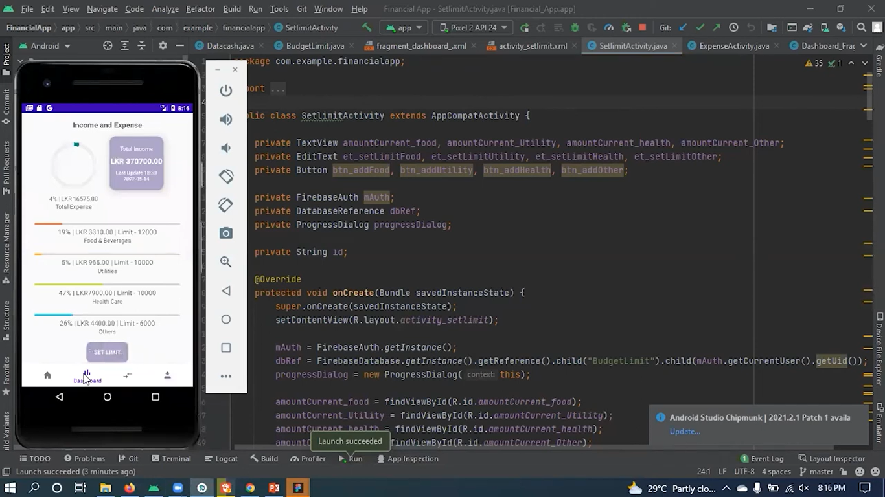

Slide 13
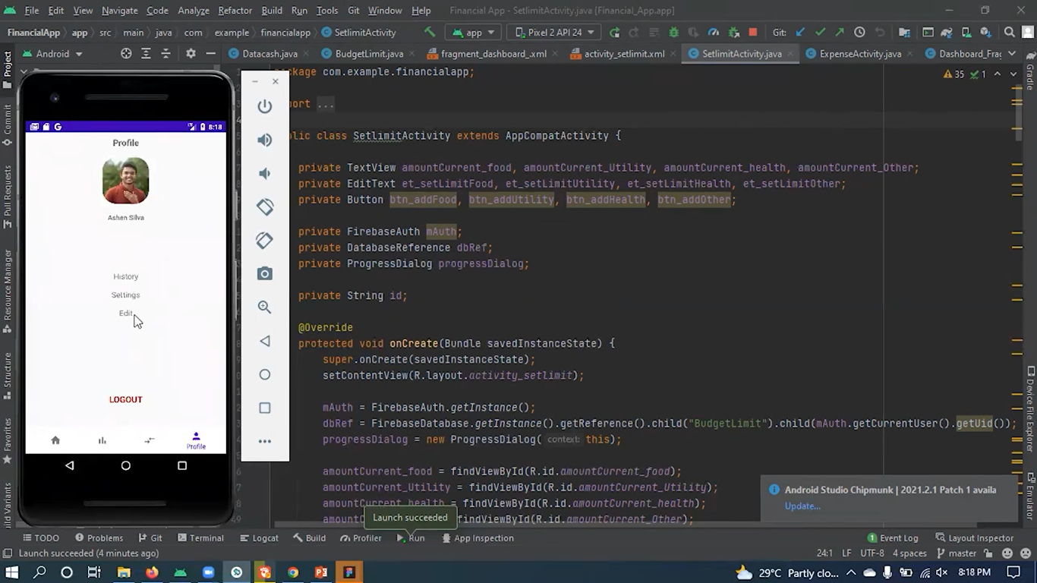
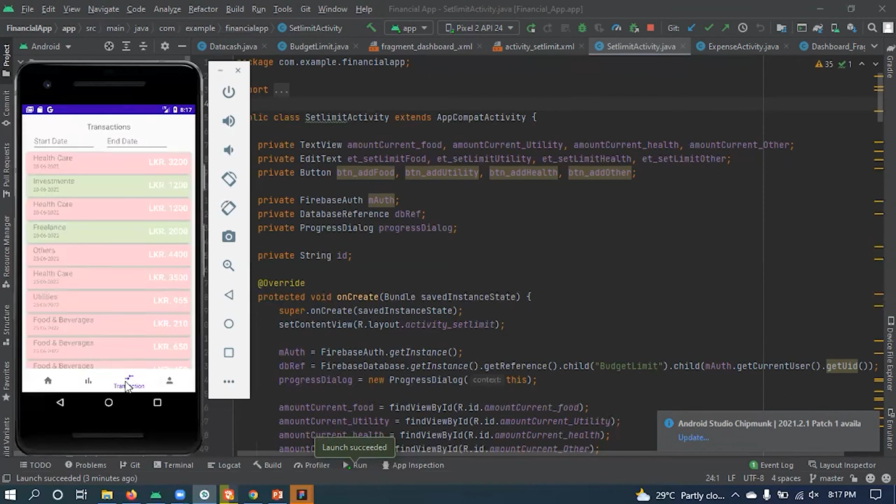

Slide 14


